Slide 1

NARA: News Articles Recommender and Analyzer
Ryan Bae
Crystal Ding
Charles Duze
Mohammed Helal
Paul Wright
Team: WeReadTheNews
https://github.com/heybaebae/news_analyzer

Slide 2



Problem Statement
Current search engines only take keywords, but we want to find similar articles based on a reference article!
OUR LOGO HERE

Slide 3
Background
NARA does 3 things:
Recommends news articles based on topic relevance
Analyzes sentiment of news articles
Visualizes news articles
How does it work?
Takes user input query article or keyword/phrases from UI
Recommends relevant articles from corpus using LDA
Lists relevant topics for query article
Presents sentiment analysis based on number of positive/negative/neutral sentences in input
Visualizes query article using word cloud

Slide 4




Target Users
Researchers
Academics looking for specific news articles for their research
General Public
News enthusiasts looking for similar articles
Users who want sentiment and topic information on an article

Slide 5
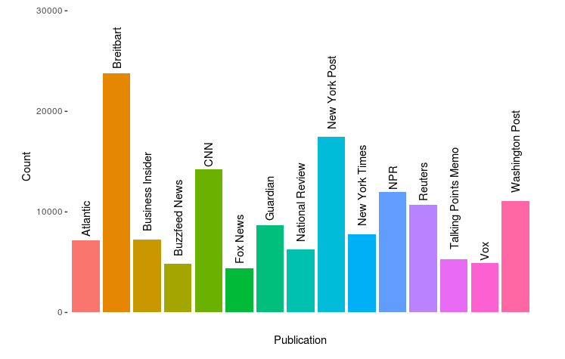
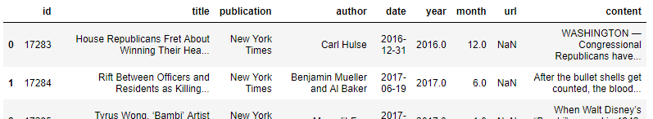
Data Sources
Main: Kaggle All-the-news dataset
Our news articles corpus
140,000 articles including article title, author, publisher, content and date
Articles from 2015 to 2017 from 15 national US publishers
Secondary: NY Times topic category labels and seed words
News article topics from NY Times
Passed through guided LDA model to produce interpretable topics

Slide 6
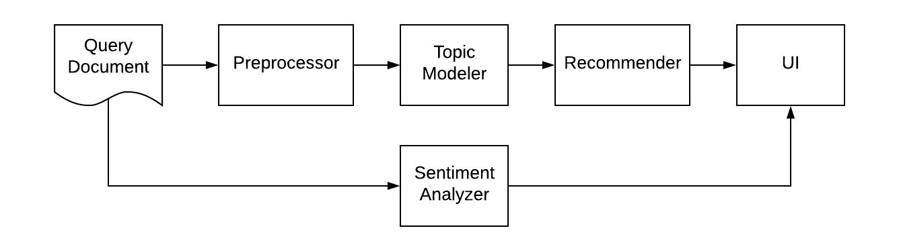
Components Structure
NARA Simplified Workflow
5 main components
Preprocessor, topic modeler, article recommender, sentiment analyzer/word cloud generator, and UI

Slide 7
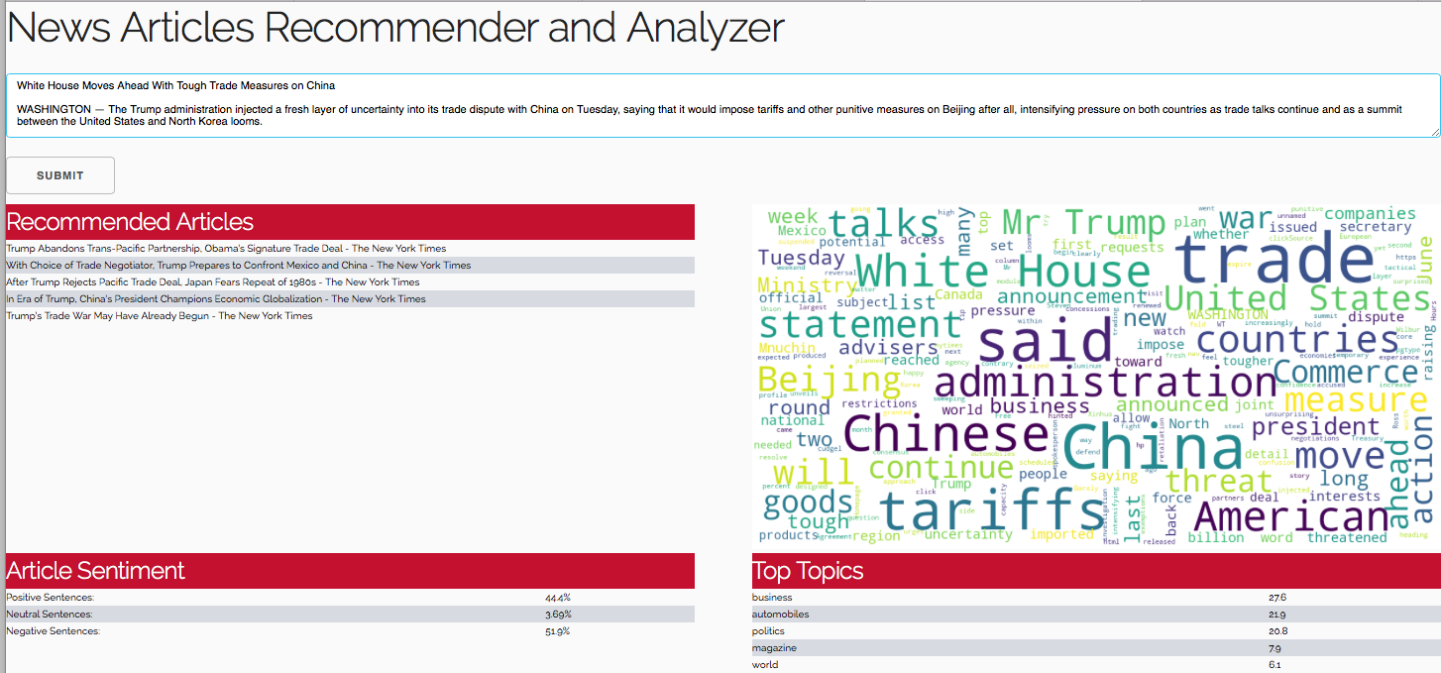
User Interface

Slide 8
Component 1: Preprocessor
Preprocessor needs to:
Clean data.
Filter words.
Return document-term-matrix for topic-modeler.
Transform new articles.

Slide 9
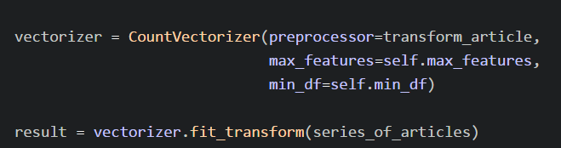
Component 1: Preprocessor
Wrapper around scikit-learn’s CountVectorizer.
max_features: maximum vocabulary.
min_df: min number of words (if int) or min proportion (float).
Class implements .fit() & .transform().

Slide 10
Component 1: Preprocessor
“transform_article” cleaning process:
Convert to lowercase.
Remove numbers and punctuation.
Remove stopwords (and, the, but, etc.).
Lemmatize (coming -> come).
Luckily, we don’t have to deal with typos.

Slide 11
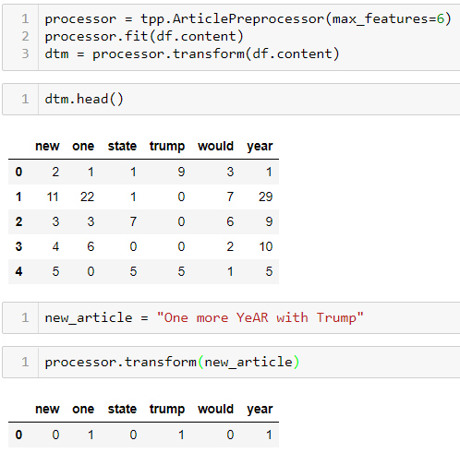
Component 1: Preprocessor

Slide 12
Component 2: Topic Modeler
Topic modeling is done using Latent Dirichlet Allocation
Guided Model – 17 topics, hand picked for interpretation and topic tags
Unguided Model - ~1400 topics, LDA algorithm picks these, used for recommender
Guidedlda module
While not as powerful as modules like gensim, it allows flexibility of both models

Slide 13
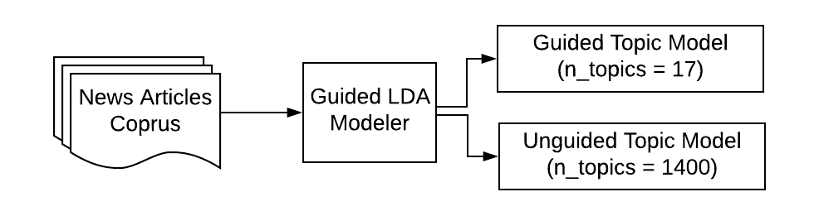
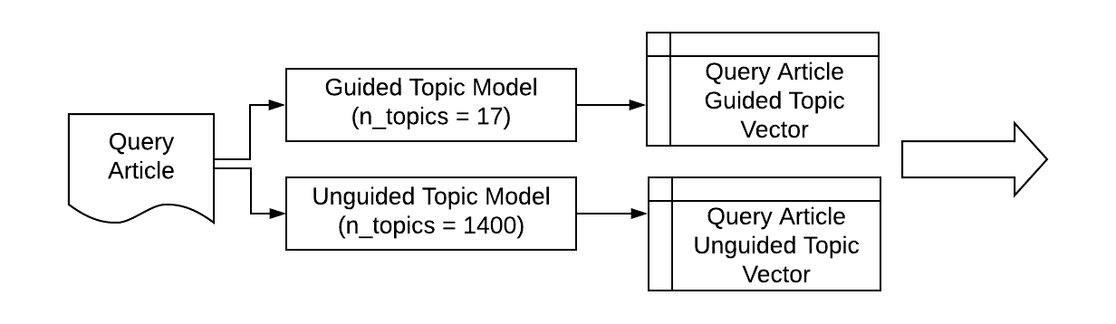
Component 2: Topic Modeler
Interpretable, high level topics, used for topic tags in UI
Model Building Process
Low level topics, used for recommender system
User Query Process
To Recommender

Slide 14
Component 3: Recommender
Corpus Unguided Topic Matrix
Index of top 5 articles in corpus
KDTree based on topic probability
Top 5 articles in articles corpus
User Interface
Query Unguided Topic Vector
Original articles corpus
knn_prediction
join_process

Slide 15
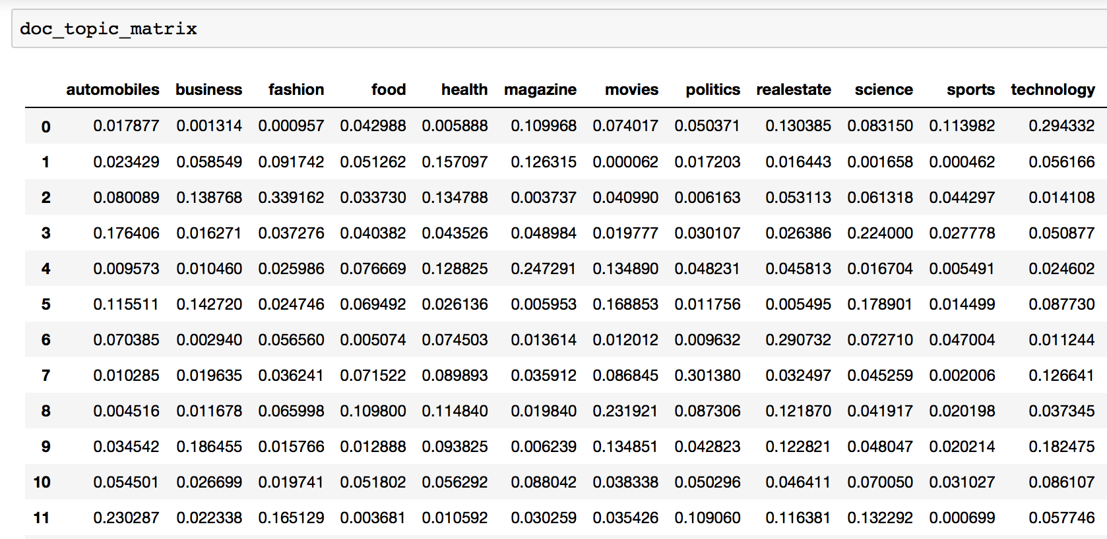
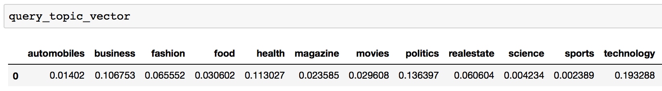
Component 3: Recommender – knn_prediction
Top Index 9
Top Topic Technology

Slide 16
Component 4: Sentiment Analyzer
NLTK
NLTK
Aggregation
Article
Sentences
Sentence
Sentiments
Article
Sentiment

Slide 17
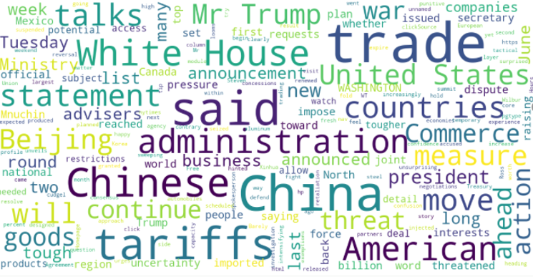
Component 5: WordCloud
Remove Stop Words
Set Parameters
Article

Slide 18
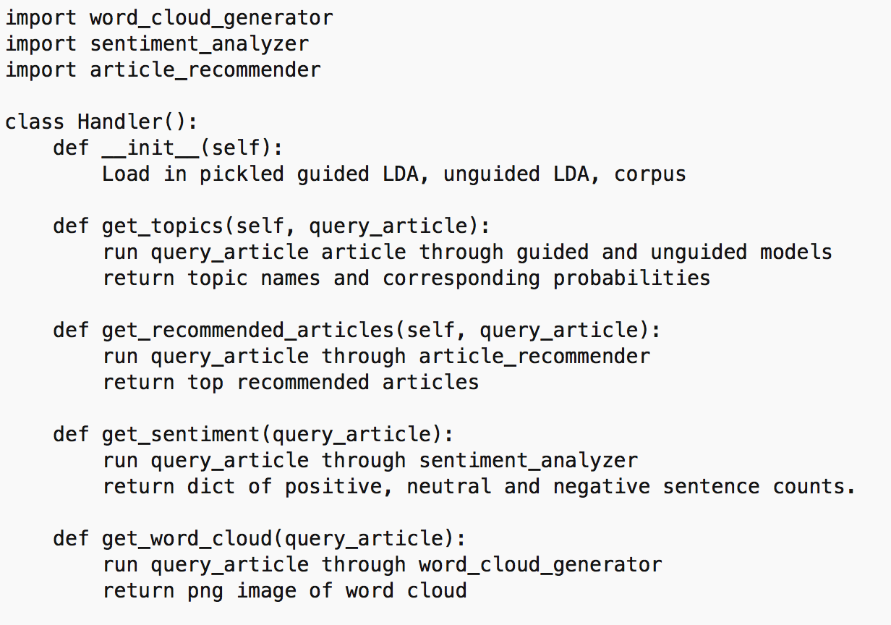
Handler Class Pseudocode

Slide 19
Demo
Demo!

Slide 20
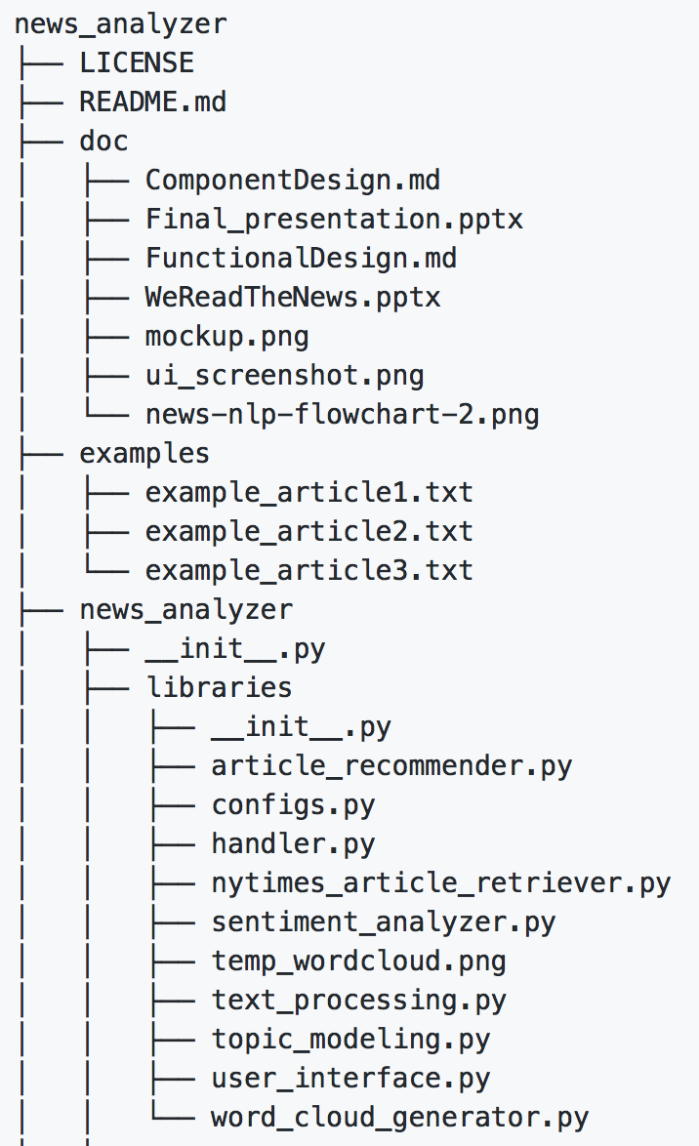
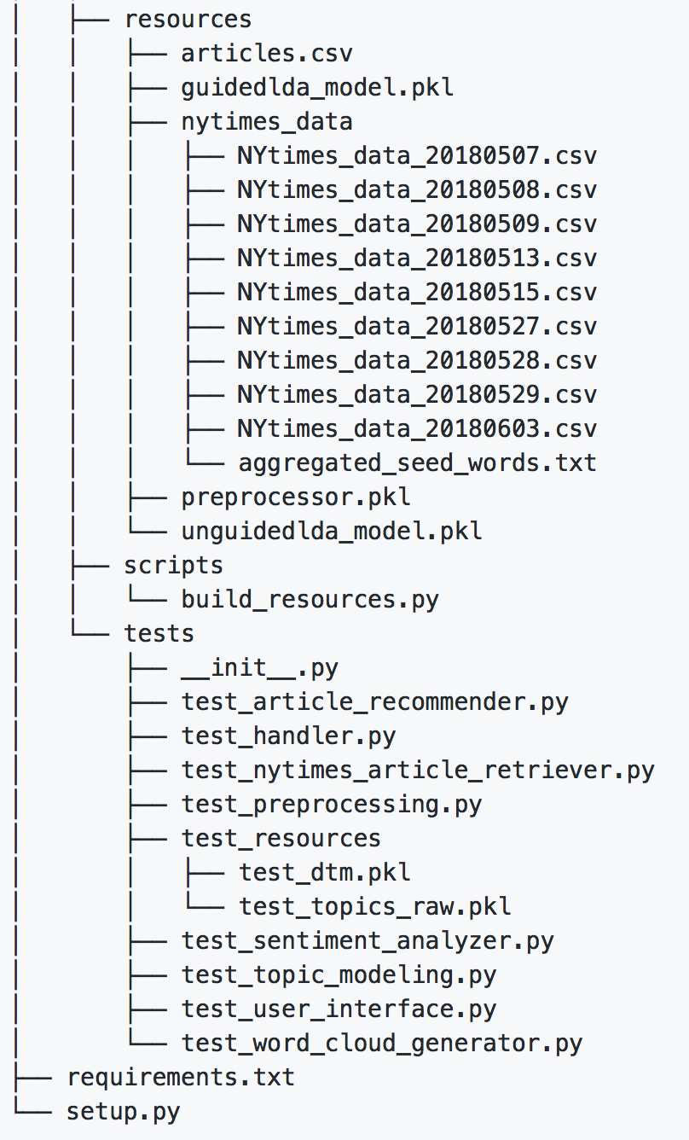
Git Repo Structure
https://github.com/heybaebae/news_analyzer

Slide 21
Problems Encountered
Dataset and model storage
Had to create build scripts to build models locally
Model tuning
Included extra stop words and deleted bad articles
NY Times seed words were time period sensitive, so had to get topic words over longer time scale
Number of topics for the LDA models had to be tuned manually
Interpretability
Not all LDA topics were interpretable
Divided topic modeling into guided topics and unguided topics

Slide 22

Future Work
Improve recommender system
Add additional non-topic related features in the recommendation system
Further optimize hyperparameters to the LDA models
Corpus-wide visualizations for data exploration
UI Prettification

Slide 23
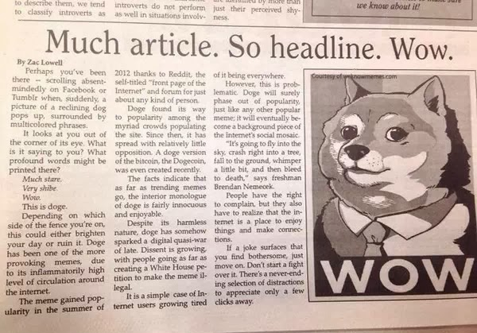
Questions?

Slide 24
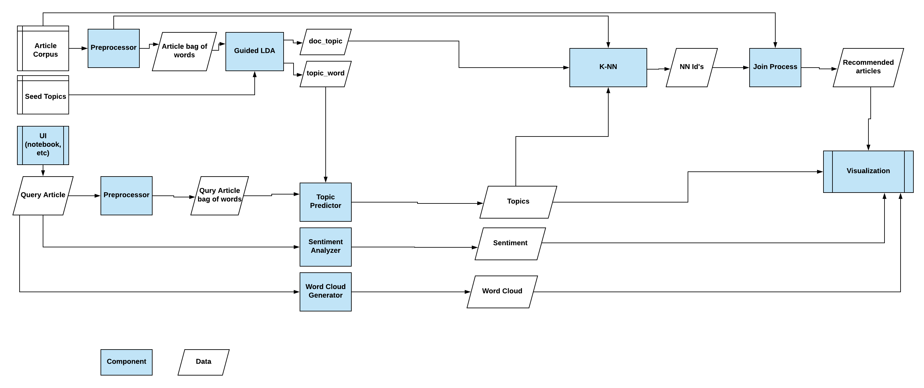
Detailed Design (Appendix)

